Slide 1
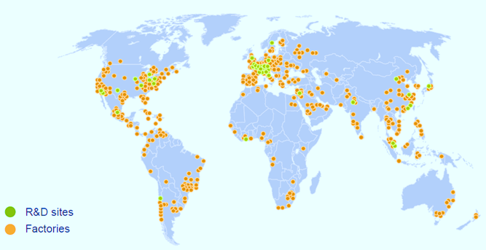
Nestlé Unmatched Geographical Presence
Geography | Sales (CHFbn) | Trading operating profit (CHFbn) | Trading operating profit margin (%) | Employees | Factories
Europe, Middle East & North Africa | 26.4 | 5.0 | 19.0% | c.109,000 | 151
Asia, Oceania and sub-Saharan Africa | 16.2 | 2.7 | 16.7% | c.110,000 | 109
Americas | 14.5 | 2.8 | 19.3% | c.109,000 | 158
Source: Public information

